Slide 1
CS3205 – HCI in Software Development Introduction
Dr. Mark Floryan
Rice Hall 203
mrf8t@cs.virginia.edu

Slide 2
Important Things First!
Put away your laptops now ☺
Trust me, you don’t need one for this class. If you have it out, I will make mental notes and deduct from your participation grade (which is worth 10% of your grade).
Seriously…don’t use them, it is pretty obnoxious (for this course anyway).
If you have an academic reason why you MUST have a laptop, then talk to me.
Note that studies show taking paper notes leads to increased grades, but no equivalent result has been shown with laptops.
http://www.theglobeandmail.com/life/parenting/back-to-school/laptops-in-class-lowers-students-grades-canadian-study/article13759430/

Slide 3
Your Instructor!
Mark Floryan
Rice 203
mfloryan@cs.virginia.edu
Office Hours: Mon: 2-3:30 pm
Tue: 2-3:30 pm

Slide 4
Teaching Assistants
Graduate Students (4)
Prashant Gorthi
Jan Miguel
Sonwoo Kim
Smriti Sridhar
Undergraduate Students (2)
Jodie Ryu
Susannah Jones
Brittany Yu

Slide 5
Collab
We will be using it!
Course syllabus is up there now!
Slides will be posted there as well.
You will submit all assignments to Collab.
All assignments must be in pdf format

Slide 6
What is HCI?
*Human–computer interaction (HCI) involves the study, planning, and design of the interaction between people (users) and computers. It is often regarded as the intersection of computer science, behavioral sciences, design and several other fields of study.
*From Wikipedia

Slide 7

Goals of the course!
This course focuses primarily on the engineering aspects of HCI.
User/Task Analysis, Prototyping, Empirical Evaluations, etc…
Don’t Worry Though!
We WILL pay respect to the design, psychological, and sociological aspects of HCI.

Slide 8
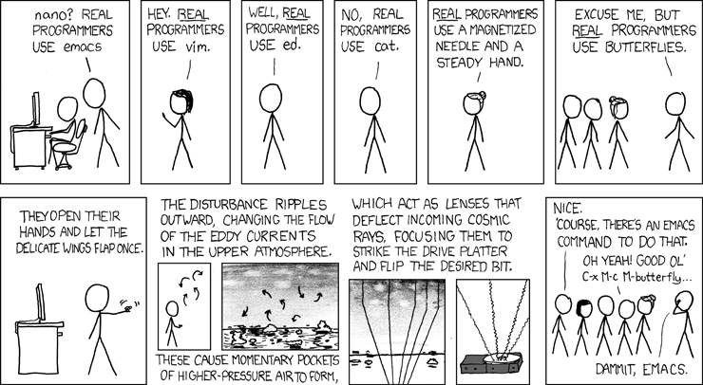
Funny!

Slide 9
Structure Of The Course
Five Modules!
1. Introduction / History of HCI
Short and simple module.
2. Understanding Users and their Tasks
Performing user analyses
Defining user and software tasks
Etc.

Slide 10
Structure Of The Course
3. Conceptual Models / Design Principles
High level design principles for interfaces
Conceptual Models & Paradigms
Etc.
4. Prototyping
Creating partially complete examples of alternative interfaces
Tradeoffs involved in prototype design
Etc.

Slide 11
Structure Of The Course
5. Evaluation Methodologies
Comparing alternative prototypes empirically.
Some simple quantitative and qualitative research methods.
*. Event Listener Model
How to code up a UI from scratch
What is the most common design pattern used
I will likely ask you to code up some UI elements (e.g., button and such) from scratch

Slide 12
Grading
Midterm Exams (2): 30%
Final Exam (1) 25%
Homework: 35%
Participation: 10%
Presentations
Class Discussion
Group Evals (Yes, your group will grade you)

Slide 13
Class Participation
You are expected to:
Ask questions
Contribute to discussions
Take in-class exercises seriously
I hope that you will:
Send me cool videos, images, etc. of cool HCI applications to show in class
Had trouble opening a door? Take a picture of it and send it to me.
Piece of software that frustrates you all the time…send it to me!!

Slide 14
Example HCI Application
http://www.youtube.com/watch?v=hNbUCKT_aho

Slide 15
Another Example of HCI

Slide 16
Another Example of HCI

Slide 17

Textbook!
Interaction Design: beyond human-computer interaction (Rogers, Sharp, Preece)

Slide 18

Required Reading!
Design of everyday things by Don Norman

Slide 19
Project
5’ish Homework Assignments
HW 5’ish is the ‘final project’ for the course and is an amalgamation of the earlier assignments.
Homework 1: Define a Project
Done individually
Ideas will be coalesced and everyone will choose projects they wish to pursue for HW 2-5.
Thus, many of you will not do your own.
You may work in groups of up to 4 on HW 2-5.
Up on Collab RIGHT NOW
Due next Tuesday by 3:30!!!!

Slide 20
Approximate Homework Breakdown
Homework 1: Project Proposal (Individual assignment)
Present / pitch ideas in class (Date TBD).
Homework 2: Analysis of users and conceptual framework
Homework 3: Prototyping
Homework 4: Evaluation of Prototypes
Homework 5: Final Report

Slide 21
Final Project Deliverable
You will turn in (as HW 5’ish) a 25-35 page technical report describing your project in full detail (One report per group).
Don’t worry, most of these pages will be from your homework assignments.
Smaller groups will submit shorter documents.
NOTE: Hopefully, this document will serve as a nice writing sample or example work for a portfolio or the like.

Slide 22
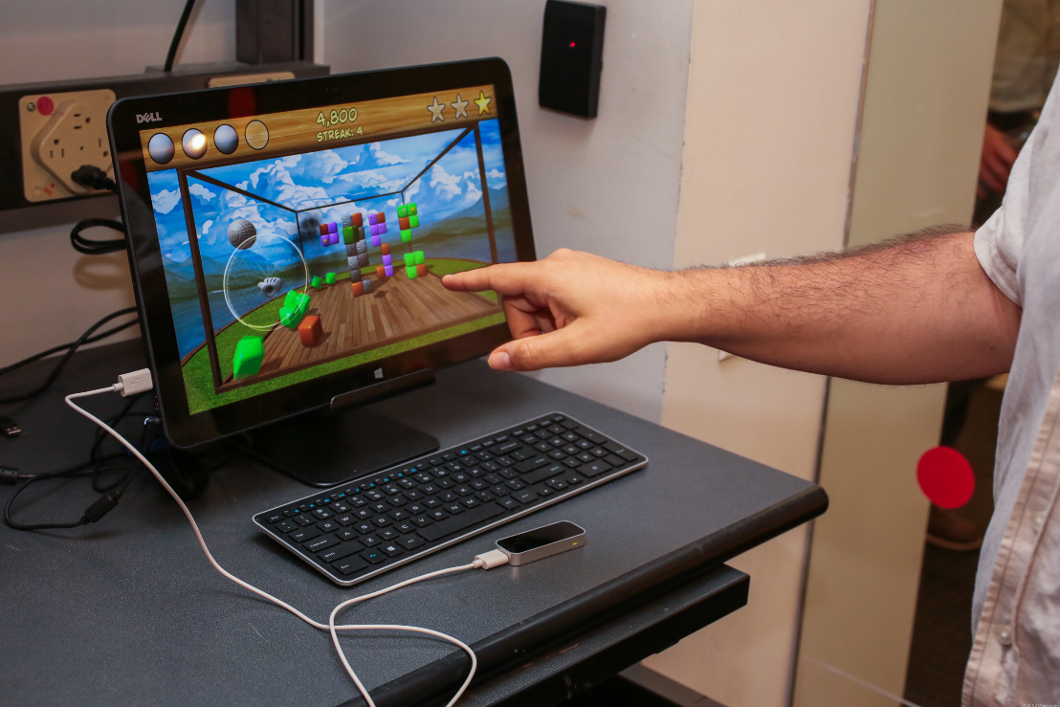
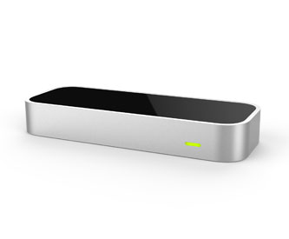
Some cool toys!

Slide 23

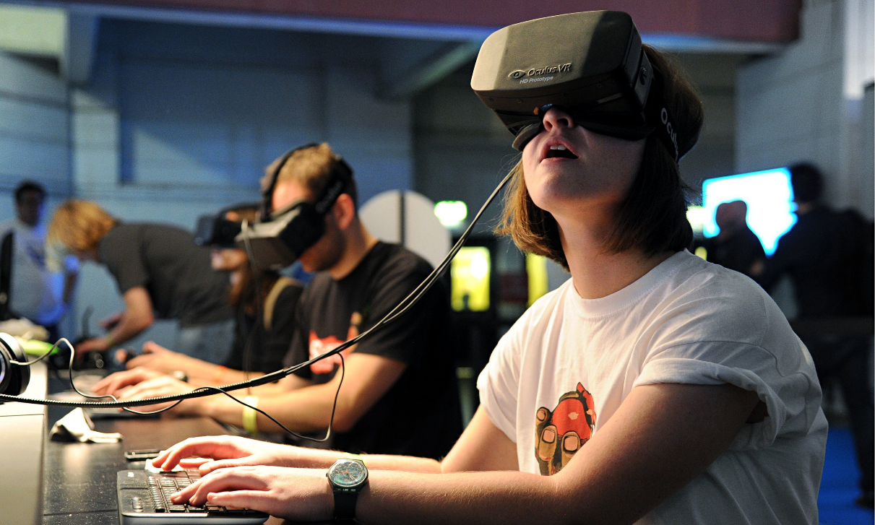
Some cool toys!
https://www.youtube.com/watch?v=pVdZh03ju6U

Slide 24


Some cool toys!
https://www.youtube.com/watch?v=v1uyQZNg2vE

Slide 25
Some Common Questions (& Answers)
How much coding will I need to do for this class?
Between ‘none’ & ‘a lot’ ← For the project
You will have the one programming assignment…maybe?
Your assignments are a little vague, how do I know if I’ve done enough work?
My assignments can be a bit ill-defined. If you do what is asked (no more, no less), you will get a B or B+ on the assignment.
How do I know if I’m on the right track?
This is why we have office hours in this course. We are happy to read drafts of your HW assignments. I highly recommend doing this!
This is basically an opinion class, right?
Sigh…

Slide 26
Any Questions!?
Coming Up:
(Very) Brief history of HCI
Analyzing users and tasks
Conceptual Models for UI

